Slide 1
Introduction to JavaScript
Context and Graphics

Slide 2
Elements of JavaScript Context
HTML – Hypertext markup language
  A computer programming language that determines the content for web pages
  JavaScript must interact with HTML elements to have a visible influence on a web page
  The HTML canvas is the primary mechanism used for JavaScript-based animation
CSS - Cascading stylesheets
  A computer programming language separate from HTML
  This language determines the aesthetic of HTML elements and must interact with specific elements

Slide 3
Basic Web Page Structure

Slide 4
A Look at a Sample Web Page

Slide 5
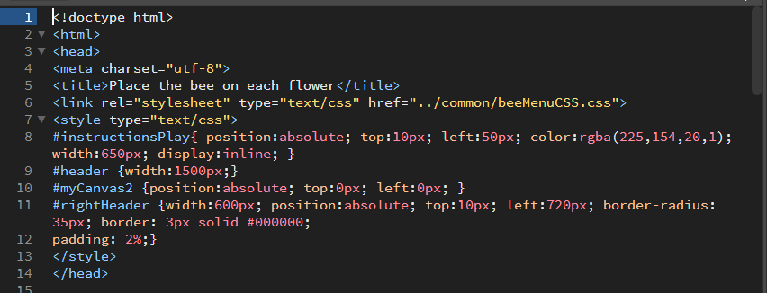
Brief Look at the Header Section

Slide 6
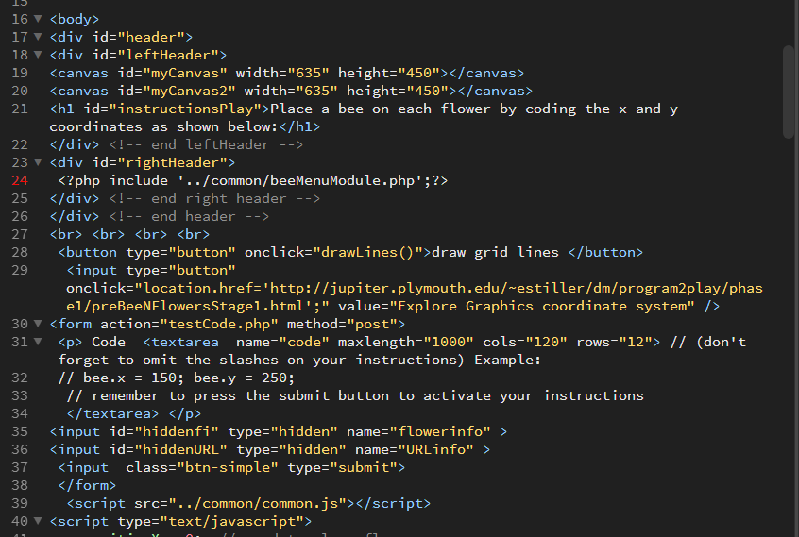
Brief Look at the Body Section

Slide 7
Introduction to JavaScript Graphics
In this course we will be drawing images on the HTML element, canvas for the bulk of our JavaScript-based graphics.
This requires:
  Reading in an image file.
  Ensuring the image file is fully downloaded before using the graphic.
  Getting a reference to an HTML canvas object.
  Drawing the graphic using the graphics context of an HTML canvas.
  This requires an understanding of the graphics coordinate system:
  http://jupiter.plymouth.edu/~estiller/dm/program2play/phase1/preBeeNFlowersStage1.html

Slide 8
Understanding the Graphics Coordinate System
Explore the graphics coordinate system using this tool:
http://jupiter.plymouth.edu/~estiller/dm/program2play/phase1/BeeNFlowersStage1.html
Answer the following questions to reinforce your understanding.
What is the range of values for X in the exploration tool? ___________________
Where is X its lowest value? __________________________________________
Where is X its highest value? __________________________________________
What is the range of values for Y in the exploration tool? ___________________
Where is Y its lowest value? __________________________________________
Where is Y its highest value? __________________________________________
What are coordinates (X,Y) for the upper left-hand corner of the graphics area?
__________
What are coordinates (X,Y) for the lower right-hand corner of the graphics area?
__________
What are coordinates (X,Y) for the upper right-hand corner of the graphics area?
__________
10) What are coordinates (X,Y) for the lower left-hand corner of the graphics area?

Slide 9
Play a game to reinforce your understanding of the graphics coordinate system
http://jupiter.plymouth.edu/~estiller/dm/program2play/phase1/BeeNFlowersStage1.html

